Slide 1
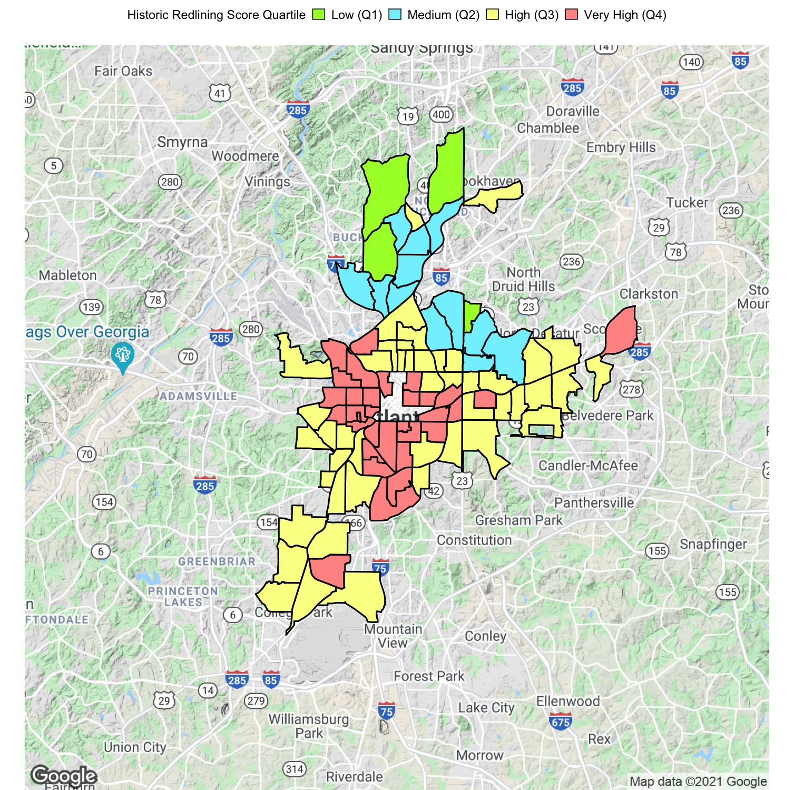
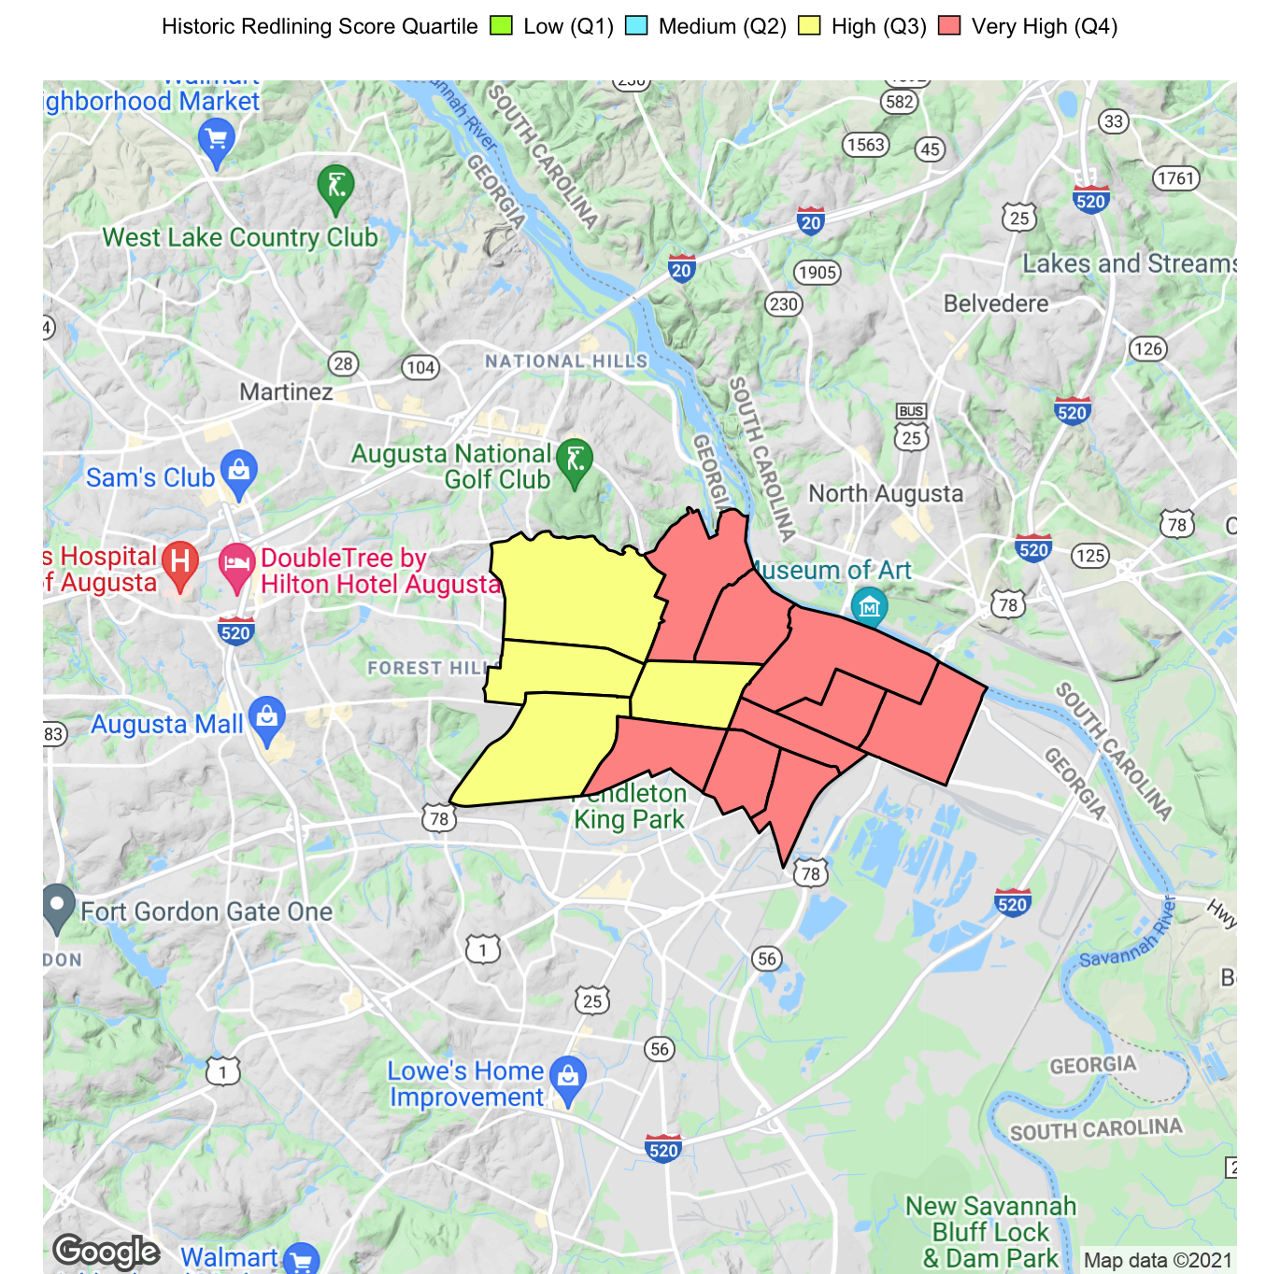
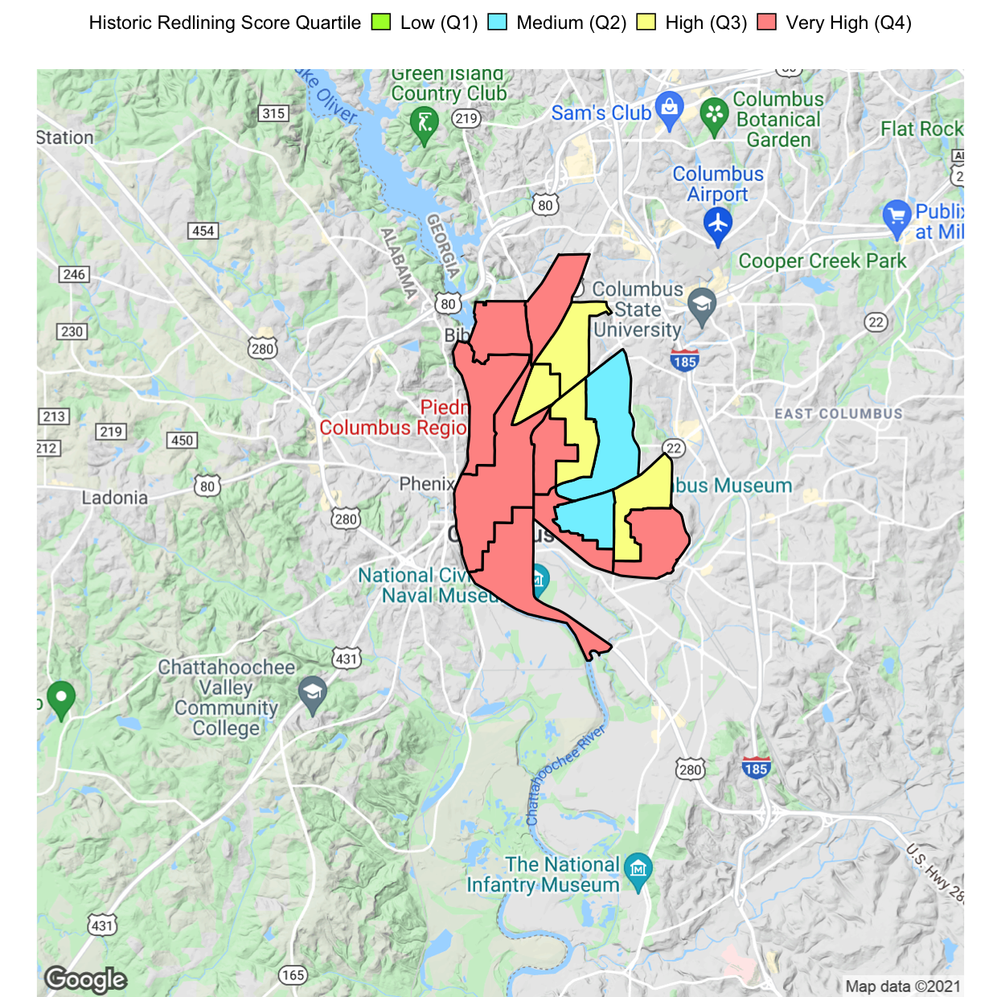
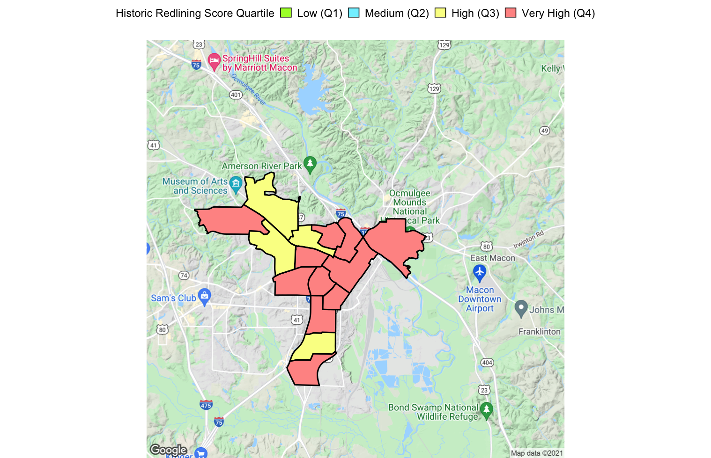
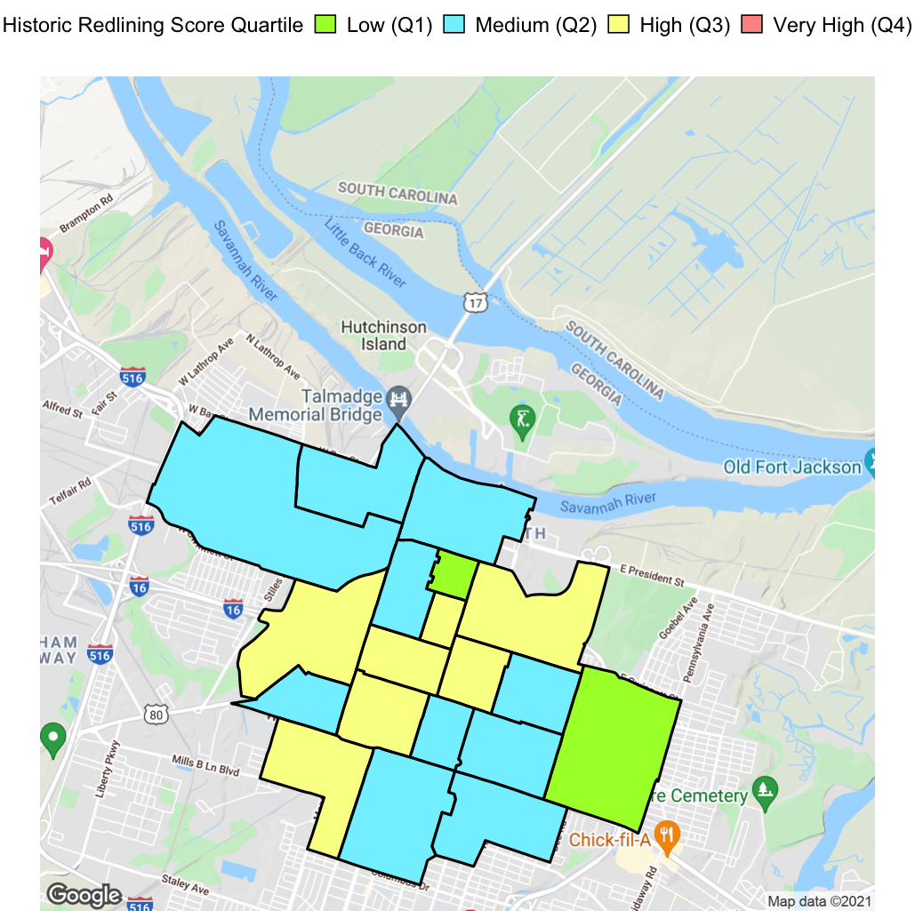
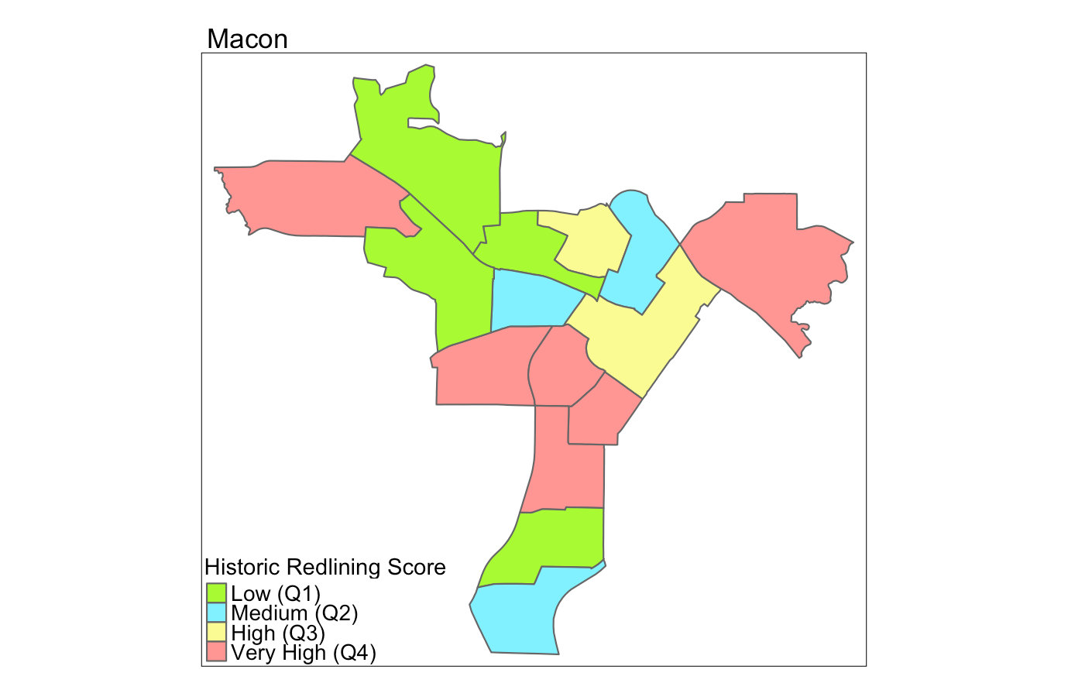


Non-Cognitive Predictors of Student Success: A Predictive Validity Comparison Between Domestic and International Students
The Impact of Historic Redlining on Toxic Air Emissions Outcomes in Georgia
METHODS
Methods methods methods methods methods methods methods methods methods methods methods methods methods methods methods methods methods methods methods methods methods methods methods methods methods methods methods methods methods methods methods methods methods methods methods methods methods methods methods methods methods methods methods methods methods methods methods methods methods methods methods methods methods methods methods methods methods methods methods methods methods methods methods methods methods methods methods methods methods methods.
RESULTS
Results results results results results results results results results results results results results results results results results results results results results results results results results results results results results results results results results results results results results results results results results results results results results results results results results results results results results results results results results results results results results results results results results results results results results results results results results results results results results results results results results results results results results results results results results results.
Jasmine Aqua, Susan Hoffman, Leah Moubadder
BACKGROUND
Background background background background background background background background background background background background background background background background background background background background background background background background background background background background.
Atlanta
Augusta
Table 2. Orindary least squares regression (OLS) and spatial Durbin model (SDM) for NATA Respiratory Hazard Index
 | All Cities (n=154) |  |  |  |  | Atlanta (n=93) |  |  |  |  | Macon (n=15) |  |  |  |  | Columbus (n=14) |  |  |  |  | Augusta (n=13) |  |  |  |  | Savannah (n=19)
 | OLS |  | SDM |  |  | OLS |  | SDM |  |  | OLS |  | SDM |  |  | OLS |  | SDM |  |  | OLS |  | SDM |  |  | OLS |  | SDM
 | ϐ | SE | ϐ | SE |  | ϐ | SE | ϐ | SE |  | ϐ | SE | ϐ | SE |  | ϐ | SE | ϐ | SE |  | ϐ | SE | ϐ | SE |  | ϐ | SE | ϐ | SE
Intercept | 0.564* | 0.027 | 0.025* | 0.010 |  | 0.667* | 0.017 | 0.093* | 0.03 |  | 0.679* | 0.026 | 0.263 | 0.143 |  | 0.842* | 0.031 | 0.352 | 0.21 |  | 0.590* | 0.014 | 0.304 | 0.161 |  | 0.516* | 0.014 | 0.090 | 0.061
Redlining | 0.040* | 0.008 | 0.004 | 0.003 |  | 0.014* | 0.005 | 0.011* | 0.005 |  | -0.0009 | 0.007 | -0.007 | 0.005 |  | -0.0003 | 0.009 | -0.011 | 0.011 |  | 0.005 | 0.004 | 0.005 | 0.004 |  | 0.003 | 0.006 | 0.003 | 0.004
ρ (spatial lag parameter) |  |  | 0.937* |  |  |  |  | 0.840* |  |  |  |  | 0.552 |  |  |  |  | 0.530 |  |  |  |  | 0.486 |  |  |  |  | 0.822*
AIC | -329.99 |  | -735.57 |  |  | -333.04 |  | -421.25 |  |  | -83.31 |  | -87.04 |  |  | -66.67 |  | -65.53 |  |  | -89.98 |  | -87.89 |  |  | -100.12 |  | -109.18
Oberved Moran's I for residuals | 0.934* |  |  |  |  | 0.712* |  |  |  |  | 0.362* |  |  |  |  | 0.507* |  |  |  |  | 0.268* |  |  |  |  | 0.551*
Columbus
Macon
Savannah
Take a picture to download the full paper
Notes:
Notes:
In Powerpoint, click View > Guides
Keep text within gutter guides.
Author list: Don’t split names onto two lines (e.g., “Jimmy [break] Smith”). If that happens, use a new line, unless you need the space. Bold the first names of anybody who’s presenting in person.
Intro/methods/result: Do not drop below font size 28, but if you have extra space, jack up the font size until the space is full.
Do not use color in the sidebars except in graphs/figures. It’ll pull attention from the center and slow interpretation for passersby.

Slide 2
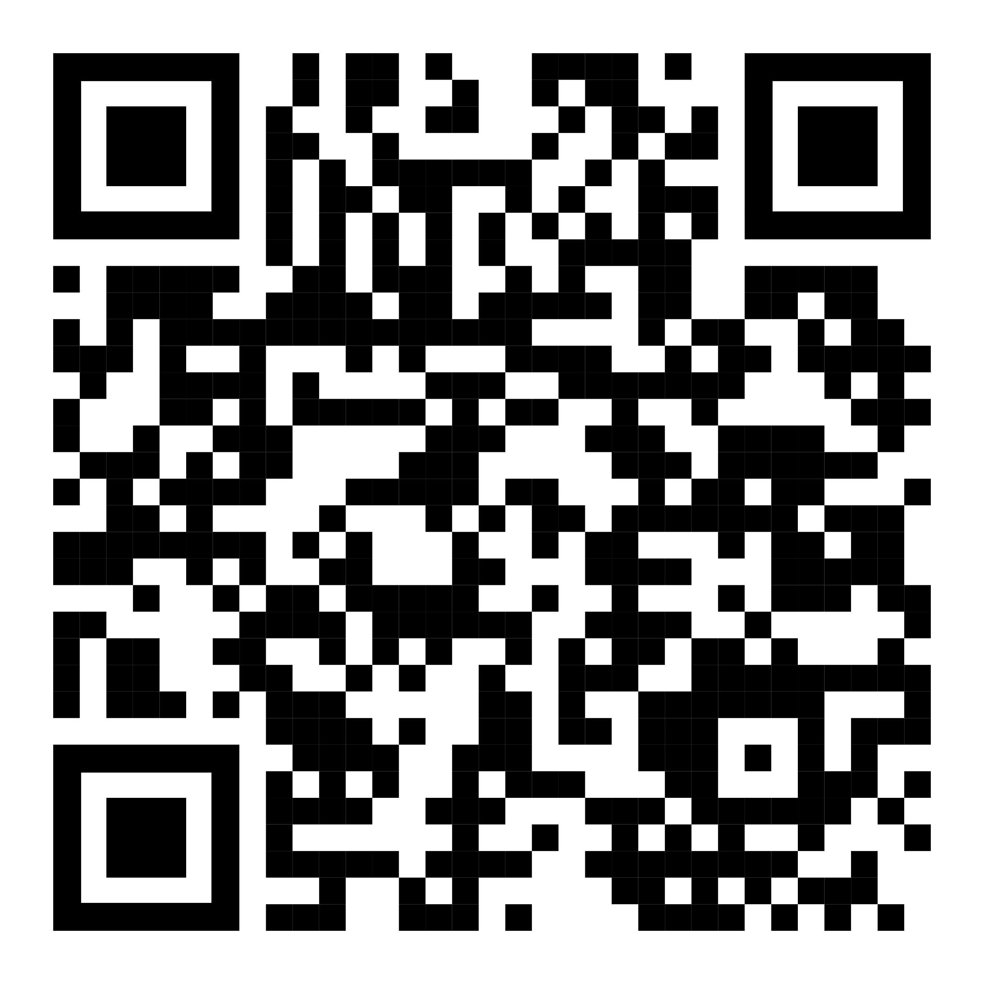
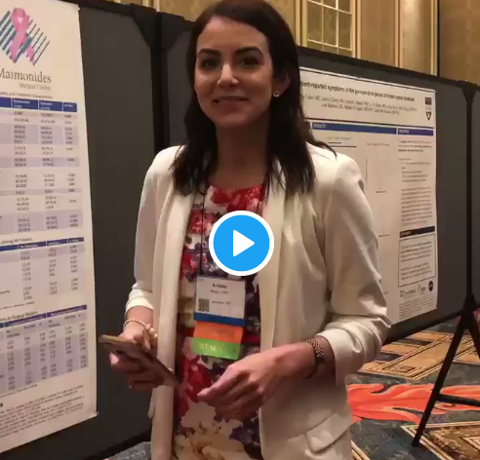

How to QR Code
How do I create a QR code?
https://www.qrcode-monkey.com/ is free, URLs don’t expire, and you can add cool features like images.
How do I scan a QR code?
Just pull out your phone and take a picture! All modern iPhones and most Android phones have built-in QR detection in their cameras. Some Android phones may need an app.
How can I link the QR to my paper and a copy of my poster and my contact details.
Try creating a multi-page link for free via https://linktr.ee/. (Still trying to figure out the best answer to this though.
Ctrl-click this thumbnail to watch a video on scanning #betterposter QR codes.
Donated by @kristinrojasmd
https://twitter.com/kristinrojasmd/status/1124418213050298368

